Slide 1
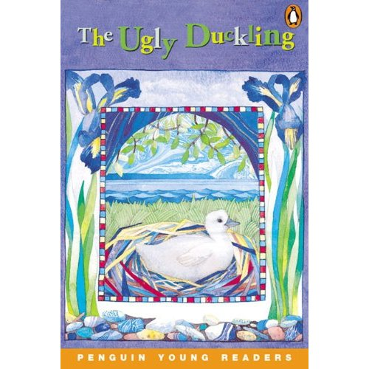
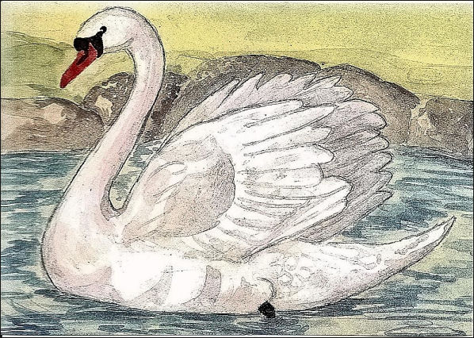
The Ugly Duckling by Molly Matt
English Class
Second Grade
Mrs. Martínez

Slide 2
Vocabulary
were
now
by
or
people
beautiful
swans

Slide 3
Vocabulary
were- eran
now- ahora
by-por
or- o
people- personas
beautiful- hermoso
swans- cisnes

Slide 4
Vocabulary
were
now
Were these kids ever babies?
Now they can walk.
by--or
people—beautiful-swans
By next year, they will skip or run!
People like to watch these beautiful swans.

Slide 5
What is a poem?
A poem is a collection of words that express an emotion or idea, sometimes with a specific rhythm.

Slide 6
About the Poem
What is the poem about?
This poem is about a duckling that grows up to be swan.
Where does the poem take place?
The poem takes place in a bird’s nest and in water.

Slide 7
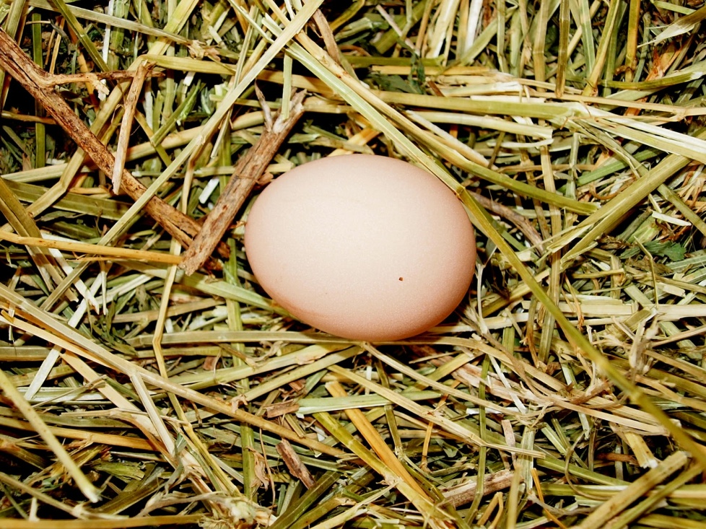
Poem: The Ugly Duckling
A big ducks sits in a nest by the lake.
A nest with blades of grass is safe.
One big egg! Is it real or is it fake?

Slide 8
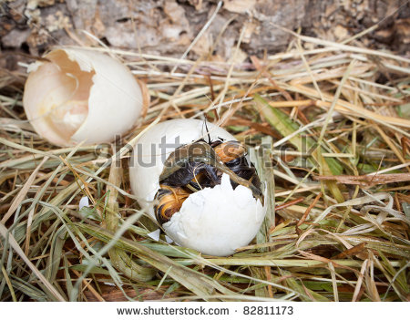
This big egg will crack, crack, crack.
First, the chick will peck, peck, peck.
Then, it will go quack, quack, quack.

Slide 9
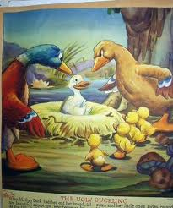
Mom Duck and chicks take a trip up a lane.
Ducks make fun of him and hiss.
It makes him sad- he is not the same.

Slide 10
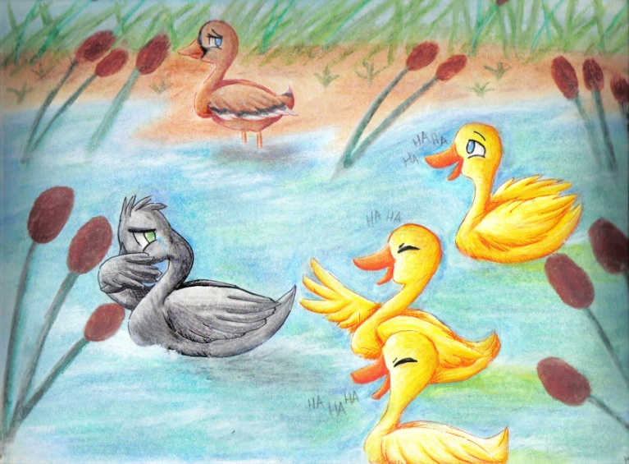
As he swims by, ducks call him names.
A frog tells Duck to just be strong.
But it makes him sad he can’t play games.

Slide 11
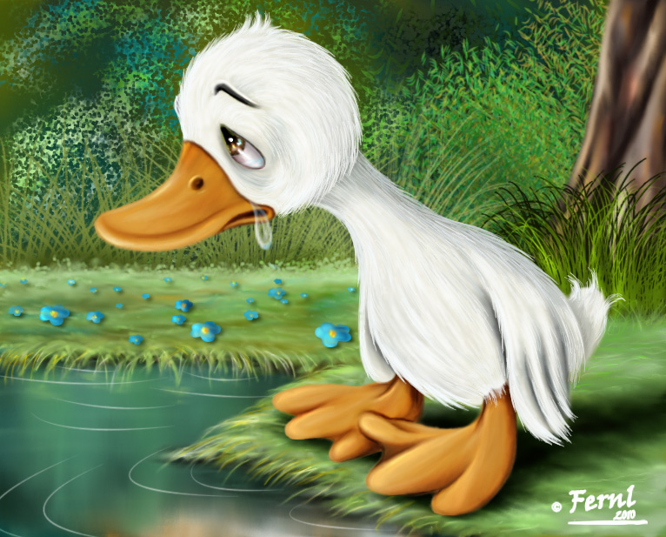
Now it is winter, and Duck is still sad.
Big flakes drop and stick as he sits on a lake.
If he were the same, this duck would be glad.

Slide 12
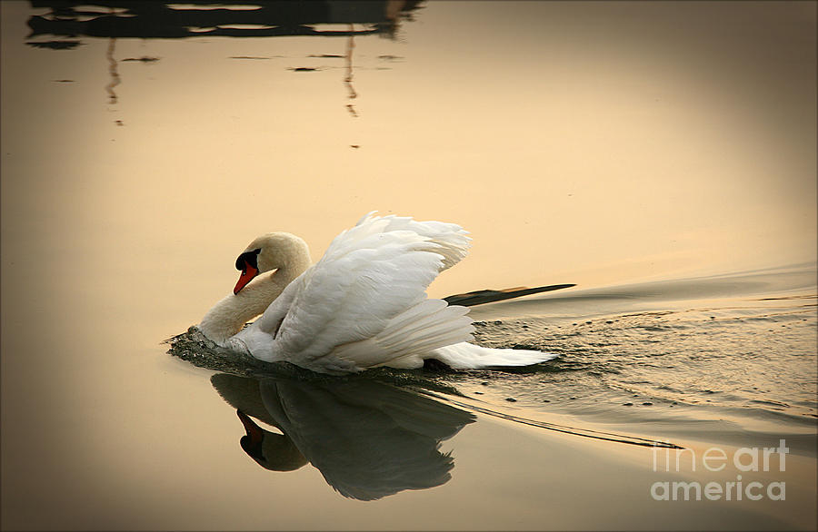
Then came the day Duck bent his long thin neck. “I am a beautiful white swan, no less!”
He was so glad he almost wept.

Slide 13
People stop and stand and wave.
Duck is glad he is not the same.
The little glum duck is now big and brave.

Slide 14
Sequence of Events
The ugly duckling hatches from a big egg.
The ugly duckling is not like the others, and they make fun of him.
The ugly duckling sees that he is really a beautiful swan.

Slide 15
Sequence of Events
3
The ugly duckling sees that he is really a beautiful swan.
The ugly duckling is not like the others, and they make fun of him.
The ugly duckling hatches from a big egg.
2
1

Slide 16
Think It Over
Who is the main character of the story?

Slide 17
Think It Over
The main character is Duck, who becomes a beautiful swam.

Slide 18
Think It Over
Why is he sad?

Slide 19
Think It Over
Duck is sad because the other ducks make fun of him.

Slide 20
Think It Over
Who is a friend to the duckling?

Slide 21
Think It Over
The frog is a friend to the little duck.

Slide 22
Think It Over
What happens at the end of the poem?

Slide 23
Think It Over
At the end of the poem, Duck becomes a beautiful swan.

